Slide 1
Cloud Native Intro
The Cloud Native Platform
Platform Architecture Team

Slide 2

WE BELIEVE
Transforming how the world builds
Software will shape the future.
Notes:
At Pivotal, we believe that Transforming how the world builds software will shape the future.
This is our core guiding principle that shapes our product development & corporate strategy
How we communicate, learn, shop, entertain vs. 10-15 yrs ago?

Slide 3

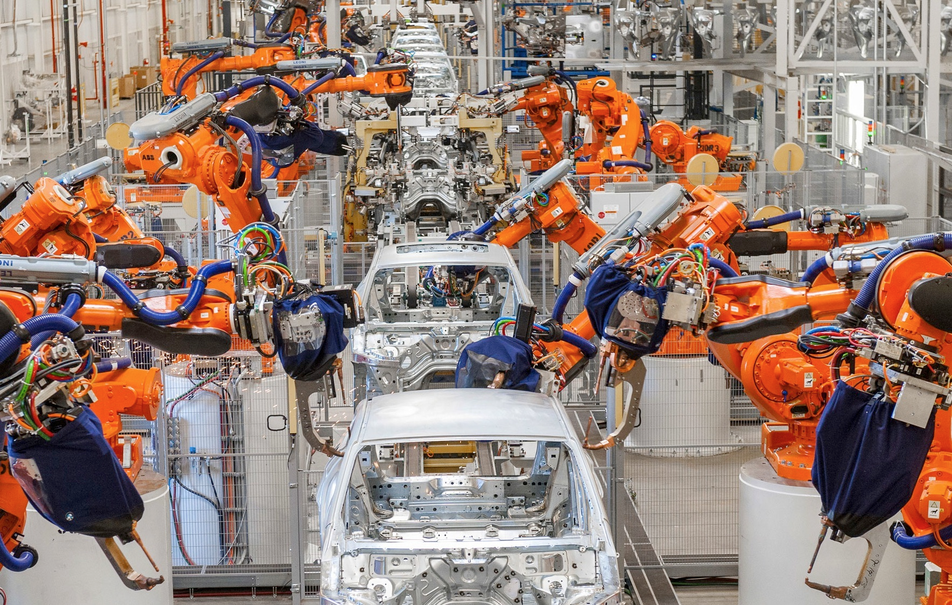
Then
Now
Manual assembly line
Dozens of features
Fully automated assembly lines
Thousands of features
Notes:
Lets begin the conversation with contrasting the past with the present.
Using the auto industry as an example, we examine at how industrialization era changed manufacturing for good.
In 1913, Henry Ford at Ford motors cut the time by half to with assembly line to produce a model T car by kicking off a manufacturing revolution, birth of the auto industry and for the first time, cars became mainstream.
Today most modern car factories roll out brand-new cars in 18 hours from sheet-metal to showroom with 100 times the number of features. What enabled this massive change was automation and a NEW way of building cars started to emerge with incredible innovation that continues till date

Slide 4
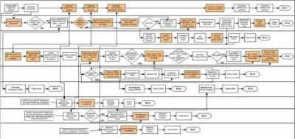
Traditional Software Deployment Models
Weeks/Months
Are you able to do full continuous delivery for every major applications today?
Dev team unable to iteratively build, deploy and test early
Operations teams overwhelmed with requests & processes
Resources in Dev & Ops tied up or they multitask between the projects
Businesses seriously impacted by:
Difficulty 2 release quickly → Slower time to market → Lost Opportunity
Lack of on-demand scaling capabilities → Downtime → Lost Revenue
75-step manual software deployment
Notes:
If this is your process to deploy the operating app. That is going to to slow down your ability to add new business functionality and new features.

Slide 5
Software Developers Spend too Much Time NOT Writing Software
Design and Coding
Brainstorming
Administrative tasks
Managing Environments
Waiting for Test/Build
Average Hours/Week
17.5 hrs ~ 40% of full work week!
*Sources: “Electric Cloud LinkedIn Survey to software developers”
Notes:
And here’s the reality.
You have a precious resource that’s spending TOO much of their time, NOT doing what you hired them to do. And for good reason?
Wouldn’t it be nice if we could significantly reduce the number of non productive hours . We won’t be able to completely remove it but we could significantly reduce it.
http://readwrite.com/2013/04/25/how-software-developers-really-spend-their-time

Slide 6
Traditional Enterprise Silos
BA
PM
Dev
QA
DBA
Ops
Project
Notes:
Let’s see how are enterprises organized around traditional application development lifecycle. We have people organized within different skill pools (Bas, PMs, Dev,…) working on a project using waterfall approach. Which means.BRD->SRS->SIS->SDS->Test Plans->MOP mixed with many different JAD sessions between each hand over. There is really no business functionality intimate knowledge and NO ownership in place. Which results in I didn’t mean that! Oh I meant this!
Evaluation & compensation impedance mismatch (business wants change and operations wants the up time so therefore no change) We see the following:
Throwing over the wall mentality, Communication problems between teams
The way success is measured in each silo can come at the expense another silo or the entire project, for example the
Ops might be measured on uptime and stability so they will resist the introduction of new technologies that are productivity enhancing … etc.
Development is measured on productivity

Slide 7
The Cloud Platform Evolution
Business Value, Agility & Cost Savings
Traditional IT
IaaS
PaaS
Applications
Applications
You Manage
Applications
Data
Data
Data
You Manage
Runtime
Runtime
Runtime
Middleware
Middleware
Middleware
You Manage
O/S
O/S
O/S
PivotalCF +
Virtualization
Virtualization
Virtualization
Servers
Servers
IaaS
Servers
IaaS
Storage
Storage
Storage
Networking
Networking
Networking
Level of Abstraction
Notes:
Developers can’t focus on development and they still do infrastructure plumbing
Bottleneck of provisioning and deployment processes

Slide 8
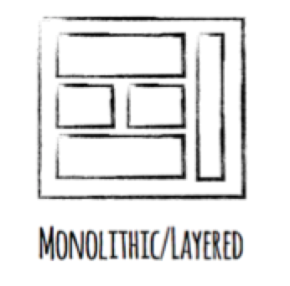
Monolith Applications
Great for the first deployment …
What about the updates ?
Tightly coupled - Holistic approach
Reliability - Adding layers & change processes
Backwards compatibility - Regression testing
Notes:
Monoliths, G8t for 1st deployment but what about day 2 (What do I need to regression testing for if I change one line of code?)
Test, deploy, release and scale as a whole. A lot of regression testing
Layers of processes to protect it.
There are new architectures emerging on top these lightweight app servers to address the scale, speed and safety: new ways of tackling cloud scale and speed to market.
These architectures have emerged from the internet giants as such an alternative: a change in culture, organization structure and technology that allows teams to work more independently, and increase velocity. It’s a key part of cloud-native applications, which we’ll talk about shortly.
Microservices are both a cultural and organizational change as a change in how we design and implement systems.
If running a busy restaurant is like producing software, restaurants can’t deal with the “Friday night rush” simply by calling in more cooks, kitchen staff, and waiters. They only have the existing capacity their kitchen facilities allow them.. adding more people to a small kitchen actually makes it worse: people start tripping over each other due to lack of space, sharing tools, and being forced to coordinate under pressure. Similarly with waitstaff.
If restaurants had a magic button that would allow them to instantly provision a whole new restaurant next door ready to go, with no wait for construction time and building permits, then presto!
Suddenly adding more people equals making food faster, and servicing a rush of customers without blinking.
In a cloud world, each team gets it’s own “restaurant”, which can be de/provisioned instantly as needed.

Slide 9
Monolith Technology Choice & Scaling
A
B
A
B
A
B
C
D
C
D
C
D
A is mission critical used all the time with predictable load
B is mission critical with spikey load
C is mission critical with low usage
D is not mission critical and is occasionally used
Notes:
Let’s say we have 4 different types of applications we need to build and run them on traditional approach & platform. We would be running them on one server so forced to make a technology choice. No one technology is the best for everything, right? One language right, but .NET might be better for GUIs based apps and JAVA might be better for building back end heavy transactional and high performing systems
Suddenly there is a need to increase capacity. How we would do this using traditional approach? How we would scale this system?
But what if different parts of a monolithic application have different scale characteristics? <CLICK X4 to build text> ROS
Some apps need more CPU power and some need more Memory
<CICK 2X to build scale>
But with monoliths, it is all or none, more often then not apps are competing for resources
Scaling out monolithic applications is difficult and can be wasteful in terms of resource usage

Slide 10
Microservices Scaling Out
A
A
A
A
A
A
mission critical 24/7 with predictable load
B
B
B
B
mission critical with spikey load
C
C
mission critical with low usage
D
not mission critical & occasionally used
Notes:
With microservices each microservice is scaled out independently
With auto scaling capabilities in the underlying PaaS that runs the micro services we can achieve very fine grained control over resource usage (CPU usage above/bellow level)
Maybe some features are CPU bound and need low amounts of RAM we can run more instances of these with lower amount of memory
Maybe some features are RAM bound and not as much CPU so we can run less CPU instances with more RAM
The ability to give each microservice the right number of instances, the right amount of RAM, Disk and CPU is one of the major benefits of micro services.

Slide 11
Technology Choices
Then
Now
Java
Go
A
B
Java
A
B
C
D
.NET
Ruby
C
D
Monolithic Application implemented using a single technology
Each microservice can be implemented using the best technology for the feature
Notes:
Each micro service can use the best technology for the problem
Pick the right language, the right type of database for the problem at hand
The MS are small enough that it should be easy to rewrite the micro service from one technology to another (CF component Ruby-Go)
Writing every MS in a different language while possible is a bad idea, the key concept is that we have the freedom to experiment with new technology and don’t get stuck for years with yesterdays technology
Overtime through experimentation the best stacks for a particular company will emerge and will be both a technical & cultural fit into the company

Slide 12

ASP
Monolithic Application
HTML
JavaScript
DLL
ASP
DLL
DLL
DLL (Nuget)
Data Access
Persistent Store
(Database)

Slide 13
ASP.NET
“Modular Monolith”
HTML
JavaScript
DLL
ASP.NET
Business DLL
Nuget
DLL
Data DLL
Persistent Store
(Database)

Slide 14
Microservices
… no more dependencies! Yeah!
HTML
JavaScript
HTTPS
HTTPS
App 3
App 1
App 2
1
2
1
2
3
4
1
2
3
4
DLL
DLL
DLL
CIRCUIT BREAKER
HTTPS
App 4
1
2
3
CACHE
DLL
Persistent Store
(Database)
Persistent Store
(Database)

Slide 15

App Journey
How does an app transform into cloud native?
4. CLOUD NATIVE
Distributed, API and microservice architectures running on time-tested technology like PCF, Spring Boot and Spring Cloud Services.
All new apps built Cloud Native
3. CLOUD RESILIENT
A 12-factor app with full metrics and monitoring, running on PCF that includes backing data services, automated failure testing & elastic scale.
Incrementally modernize and gain additional benefits
2. CLOUD FRIENDLY
A Cloud aware app built using 12-factor principles that takes advantage of Cloud for scale and resiliency
Replatform existing apps to run on PCF
1. CLOUD READY
Generally an app 0 to 7 years old that uses tech supported by the CF ecosystem and built in a modern, service-oriented manner

Slide 16
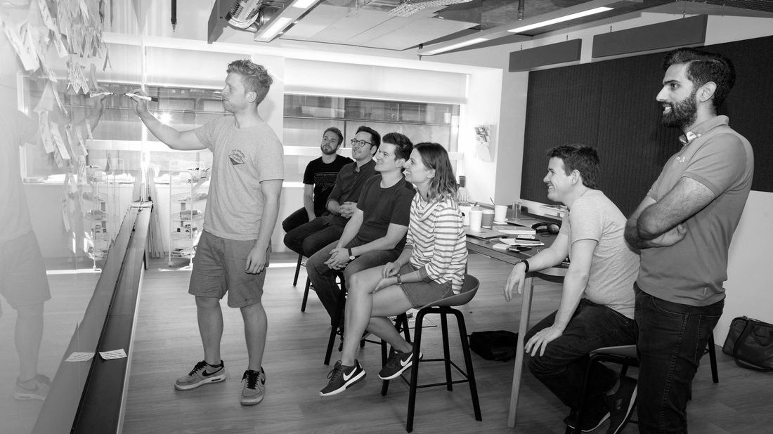
Design Considerations

Slide 17

You have a choice, but choose wisely.
dotnet Framework:
Your app currently uses .NET Framework (recommendation is to extend instead of migrating).
Your app uses third-party .NET libraries or NuGet packages not available for .NET Core.
Your app uses .NET technologies that aren't available for .NET Core.
ASP.NET Web Forms
ASP.NET Web Page
WCF services
ADO.NET Data Services
Your app uses a platform that doesn’t support .NET Core.
dotnet Standard:
Unifies the .NET implementations and prevents future fragmentation
“The vast majority of NuGet packages are currently still targeting .NET Framework. Many projects are currently blocked from moving to .NET Standard because not all their dependencies are targeting .NET Standard yet. That’s why we added a compatibility mode that allows .NET Standard projects to reference .NET Framework libraries.” - Microsoft
dotnet Core:
You have cross-platform needs.
You are targeting microservices.
You are using Docker containers.
You need high-performance and scalable systems.
You need side-by-side .NET versions per application.
 | The answer? SNAP analysis.

Slide 18
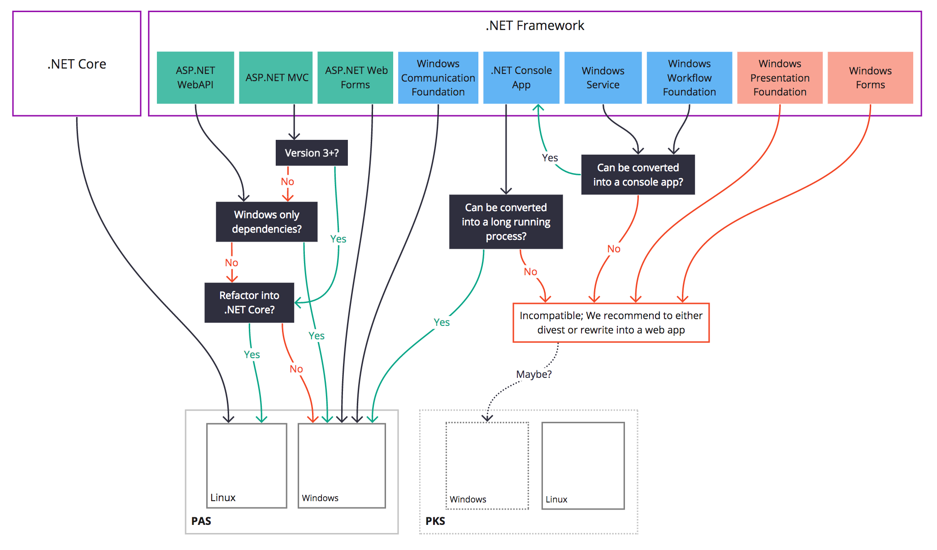
Current .NET Framework Compatibility and Recommendations

Slide 19
Writing Twelve Factor ASP.NET Applications
Avoid in-process session state*
For ASP.NET override MachineKey in web.config and on ASP.NET Core avoid persisting keyring to filesystem*
On ASP.NET avoid environment specific configuration in web.config
Avoid Integrated Windows Authentication
Avoid the GAC
Avoid custom IIS handlers
Avoid anything that uses the Windows registry
Avoid using local disk especially for storing application state*
Avoid using any Windows specific or disk based logging*
Avoid any 32-bit specific libraries or libraries that can’t be bin deployable*

Slide 20
Web.Config versus PCF Variables
The use of PCF environment variables is not required
.NET applications will continue to use the web.config for providing runtime information
Sensitive information supplied at deployment time by environment
Updating the web.config will require a code push and a restart of the application

Slide 21
Why use PCF Environment Variables?
Minimal coding impact – depending on .NET version and application type
Can refactor .NET applications to use the web.config if environment information is not available or defined
Sensitive information can be supplied at any time by environment
Updating the PCF environment variables does not require any new code to be pushed or a restart of the application

Slide 22
Logging with PCF
Easy to use logging functionality that is designed for handling multiple application instances out of the box
Pushing information into the log can be accomplished with a Console.Writeline() call
Stdout is captured by PCF for all .NET application types
Third-Party logging tools can be used with PCF logging by redirecting the log output to the console
To retain logging information, PCF logs should be drained into a repository designed to hold long-term logging information (i.e. Splunk)

Slide 23
Handling File Access
Avoid dependencies on the local file system
Use Cloud or Network Storage if possible
Mounting file shares are not supported with the Windows 2016 stemcell

Slide 24
Windows Services
Long running processes that allow execution in the background that is installed on a Virtual Machine or Physical Server
Can typically be re-platformed into a console application
Pushed to PCF as an executable with binary buildpack and start command
Routes are not used for console applications
Use process or none for health check type
Scalability and High Availability without spinning up additional Virtual Machines or Physical Servers

Slide 25
Single Sign-On
Pivotal SSO Service provides a common integration point for .NET applications
Integrates with ADFS and Active Directory
OAuth framework for .NET applications
OIDC integration with Azure AD and other OIDC providers (v 1.12)
Visual Studio can automatically provide the basic security scaffolding
ASPNET Security model using SQL Server
Built-in support for OAuth and Open ID Authentication in .NET

Slide 26
Tasks and Jobs
Tasks can be used to execute an application as a one time job
Tasks run for a finite amount of time, then stop
Use for database migrations, batch jobs, rebuilding indexes, etc.
Containers are created and then destroyed as part of the execution of the task
Container inherits environment variables, service bindings, and security groups bound to the application

Slide 27
Other Considerations
How should we handle database migrations?
Do you understand what may happen if multiple instances of the application spin up in random order?
How do we handle application recovery?
What happens when a blue/green deployment occurs?

Slide 28

Transforming How The World Builds Software
© Copyright 2017 Pivotal Software, Inc. All rights Reserved.

